Slide 1



Slide 2
What is Version Control?
A software that helps software developers to work together and maintain a complete history of their work.
Listed below are the functions of a VCS:
Allows developers to work simultaneously.
Does not allow overwriting each other’s changes.
Maintains a history of every version.

Slide 3
Version Control Types:
Two types of VCS:
Centralized Version Control System (CVCS)
Distributed Version Control System (DVCS)

Slide 4
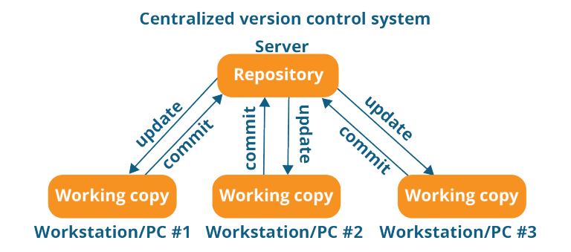
Centralized VCS
Centralized version control system (CVCS) uses a central server to store all files and enables team collaboration. It works on a single repository to which users can directly access a central server.

Slide 5
Distributed VCS
These systems do not necessarily rely on a central server to store all the versions of a project file.
In Distributed VCS, every contributor has a local copy or “clone” of the main repository i.e. everyone maintains a local repository of their own which contains all the files and metadata present in the main repository.

Slide 6
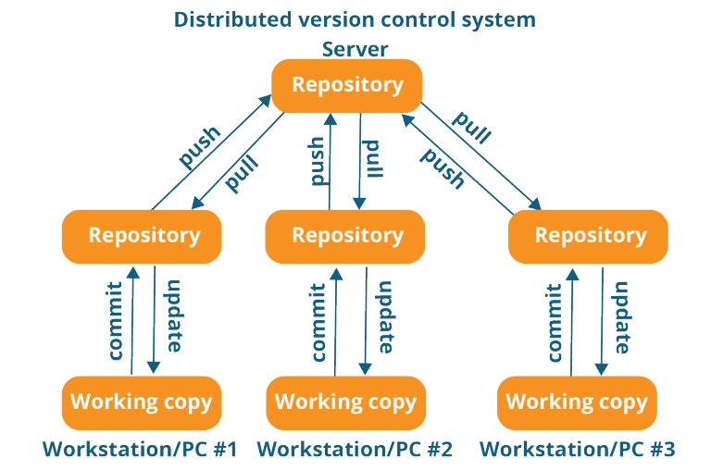
GIT

Slide 7
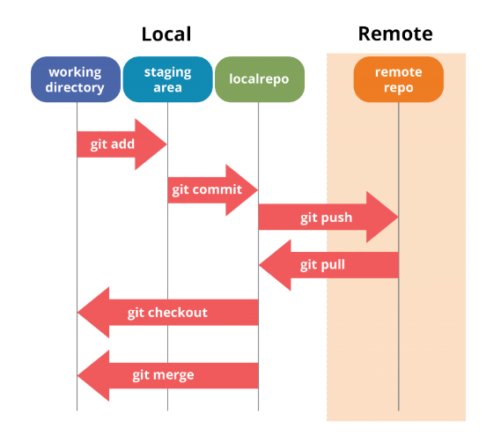
Git flow

Slide 8
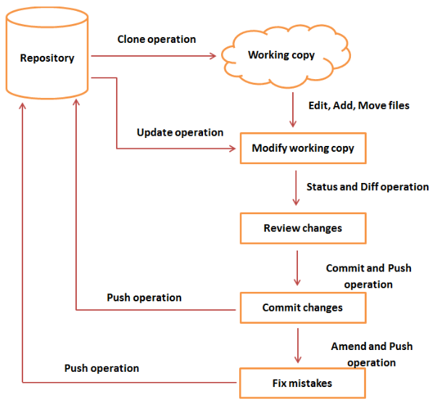
GIT Architecture

Slide 9
Git Features
Free and open source - 2005
Speed
Reliable
Implicit Backup
Secure (SSH Authentication)
Supports non-linear development(Branching and Merging)
Easy Branching
Distributed development

Slide 10
Install GIT
https://git-scm.com/download/win/

Slide 11
Git Operations & Commands
Initialize
Pull
Add
Commit
Push

Slide 12
Configure GIT
git config - - global user.name "<your name>"
git config - - global user.email "<your email>“
git config - - list

Slide 13
GIT Repositories
Bare Repository
Nonbare Repository

Slide 14
GIT Initialize
Setting up Repository in Local Machine :
git --version
git init
git remote add origin "GITHUB URL”
git pull origin Branchname
git status

Slide 15
GIT Commands & Operations
Add files and commit
git add filename
git commit -m “Commit Message“
Add Multiple Files and Commit
git add -A
git commit -a -m “Commit Message"

Slide 16
Branching
git branch branchname
git checkout branchname -- to checkout branch and to work on branchbranch
Add files and commit
git add filename
git commit -m "message"

Slide 17
GIT Log
git log -- Shows commit history
git shortlog – Shows Commit Message History
Revert Changes
Copy first 8 letters and use command
git checkout 7letters filename
git diff commit1 commit2

Slide 18
Merging
git merge branchname
git checkout Branchname
git commit -m “Commit message“
git checkout master
What Is Cherry Pick

Slide 19
Rebasing
Combines work between different workstations
git rebase master
git checkout Branchname

Slide 20
GIT Push
git push origin branchname

Slide 21
GIT SSH Authentication
ssh-keygen – Creates SSH Key
ssh -T git@github.com
cd ~/.ssh
ssh-keygen
cat id_rsa.pub | pbcopy
git config --global user.name ""
git config --global user.email "”

Slide 22
GIT Tag
To Create Tag
git tag -a v1.0 -m "Git Version 1.0”
git tag
git show tagname
git push origin branchname tag tagname
Delete Tag:
git tag -d tagname

Slide 23
Thank You
If any queries please feel free to ask

